Slide 1
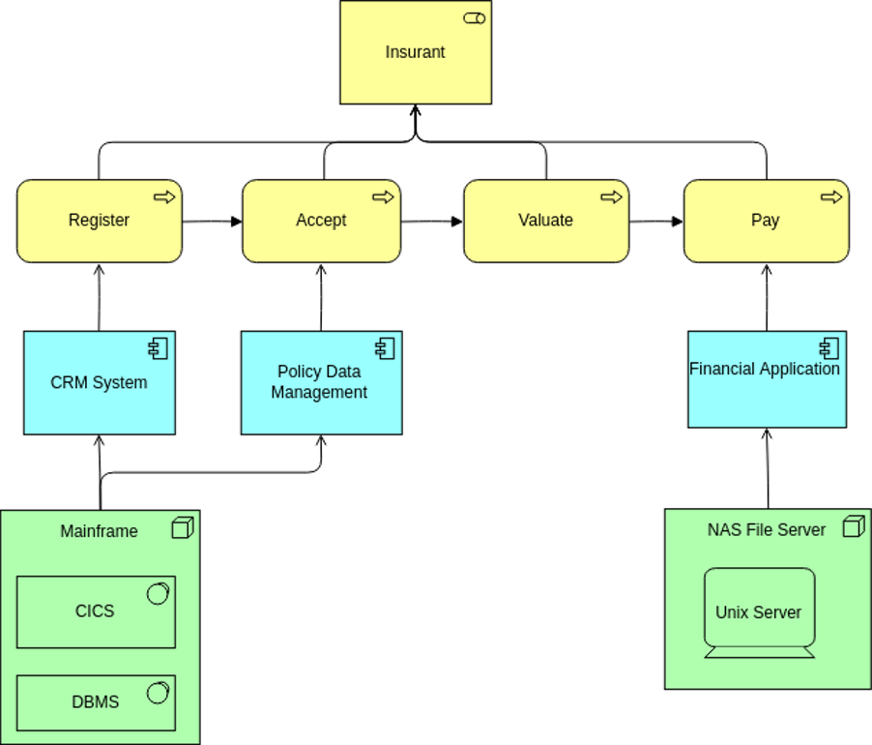


ArchiMate Cookbook in Action
Author: Eero Hosiaisluoma Instructor: Zhao Xiaoqi

Slide 2
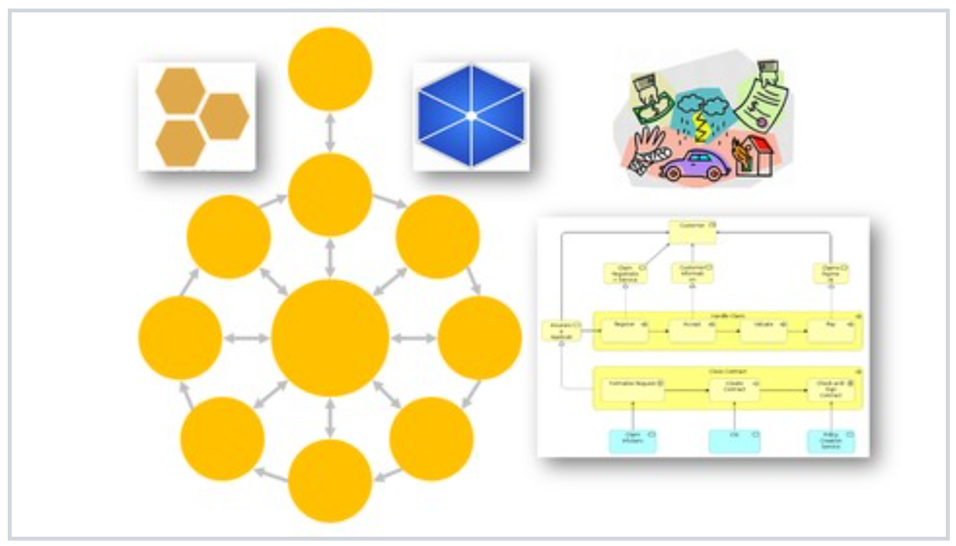
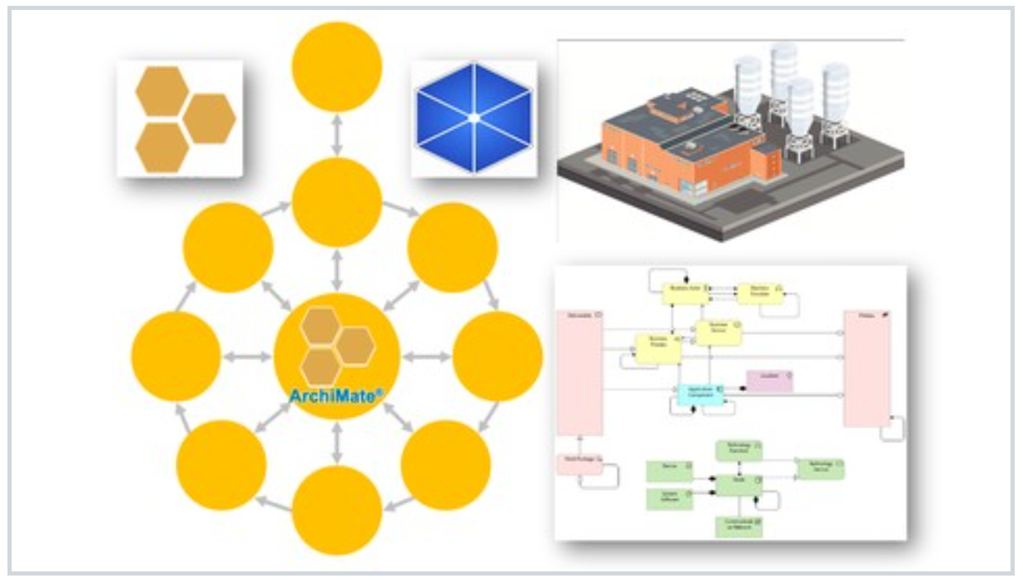
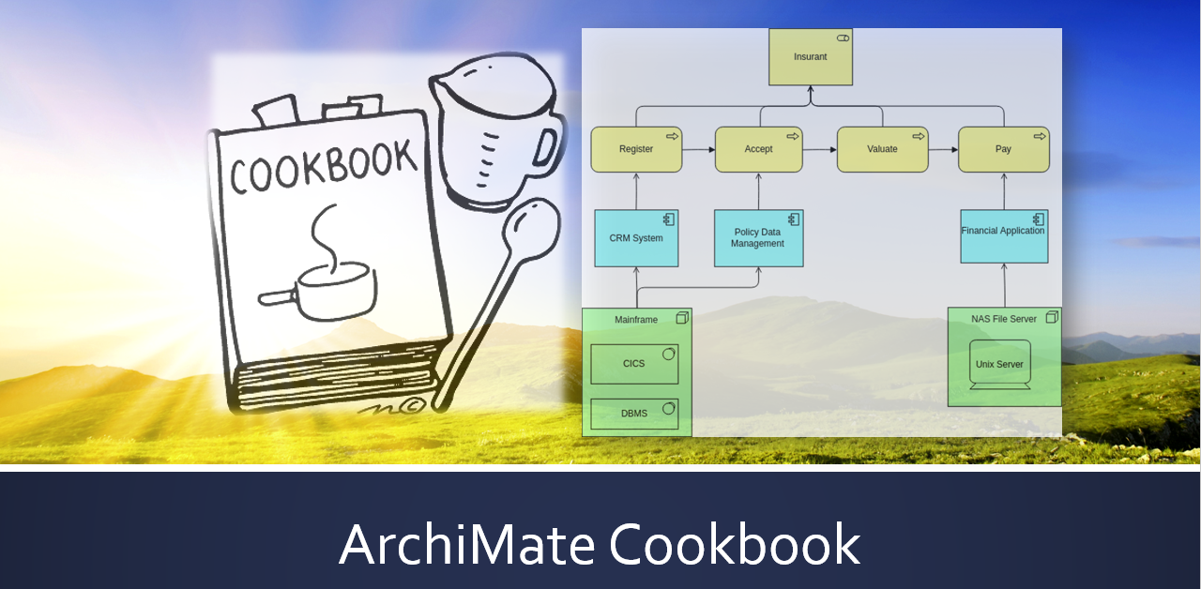
ArchiSurance
ArchiMetal
NEW

Slide 3
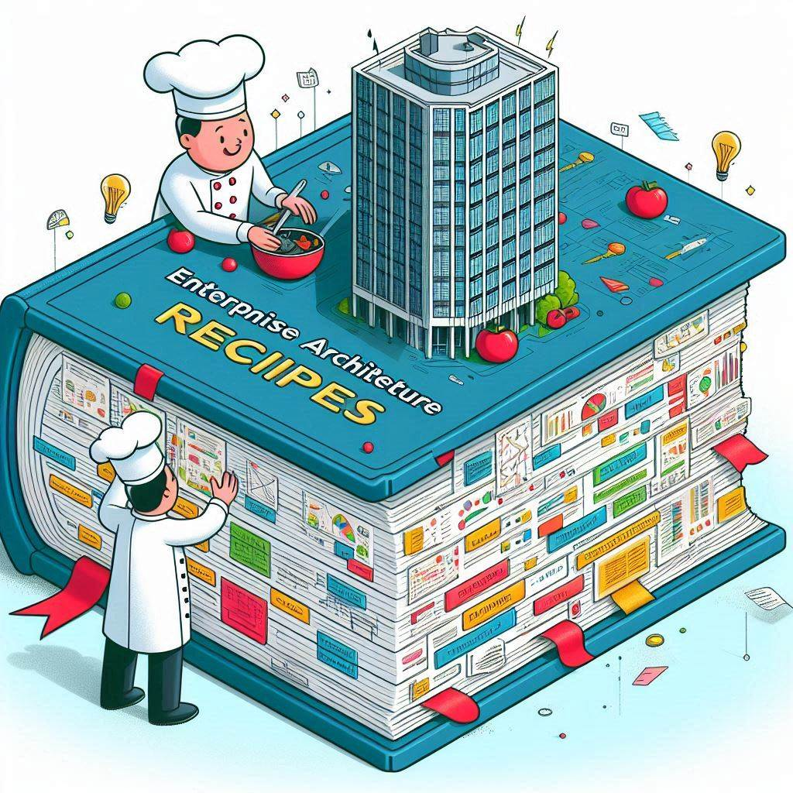


Slide 4

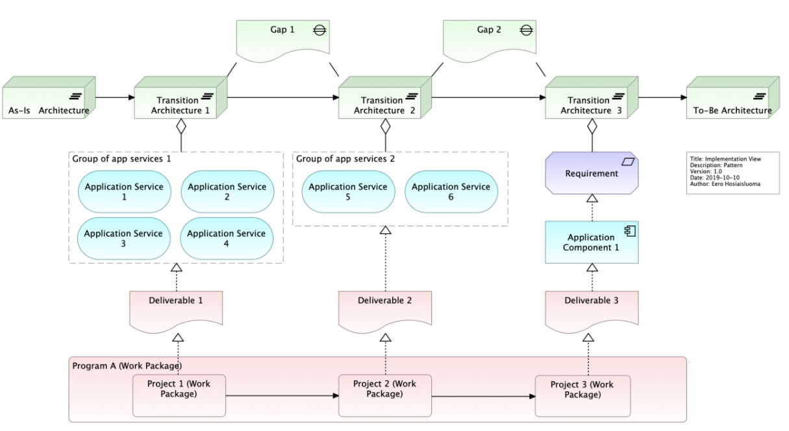
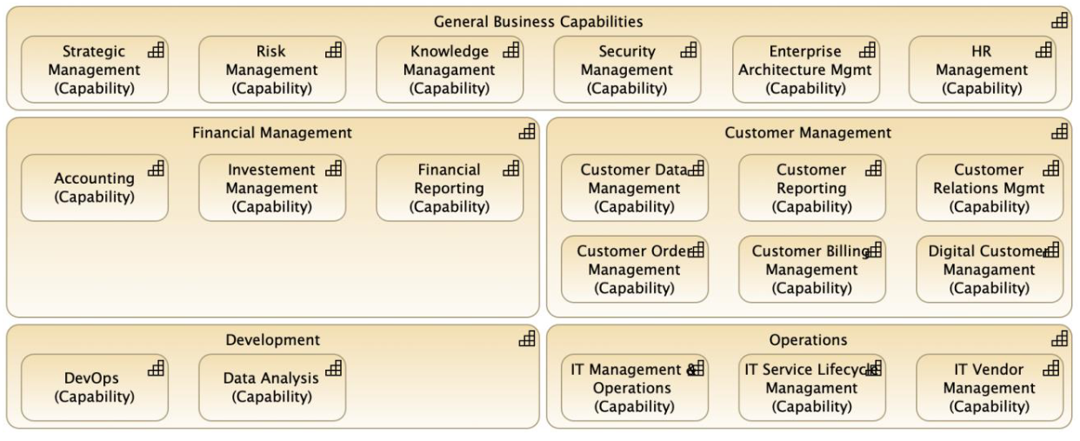
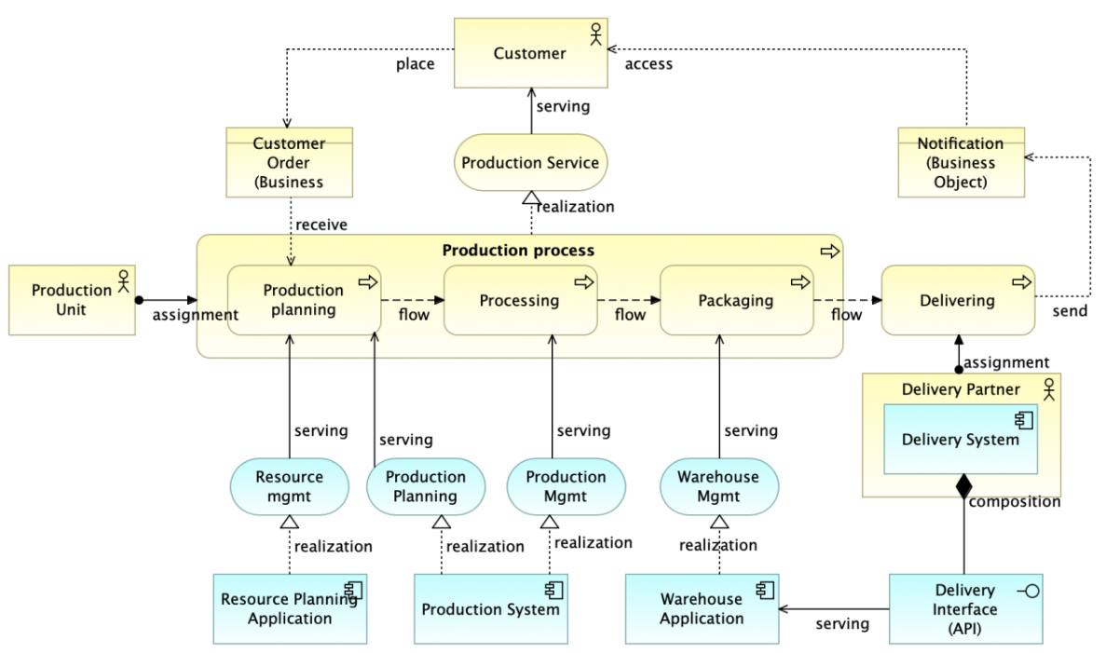

Slide 5
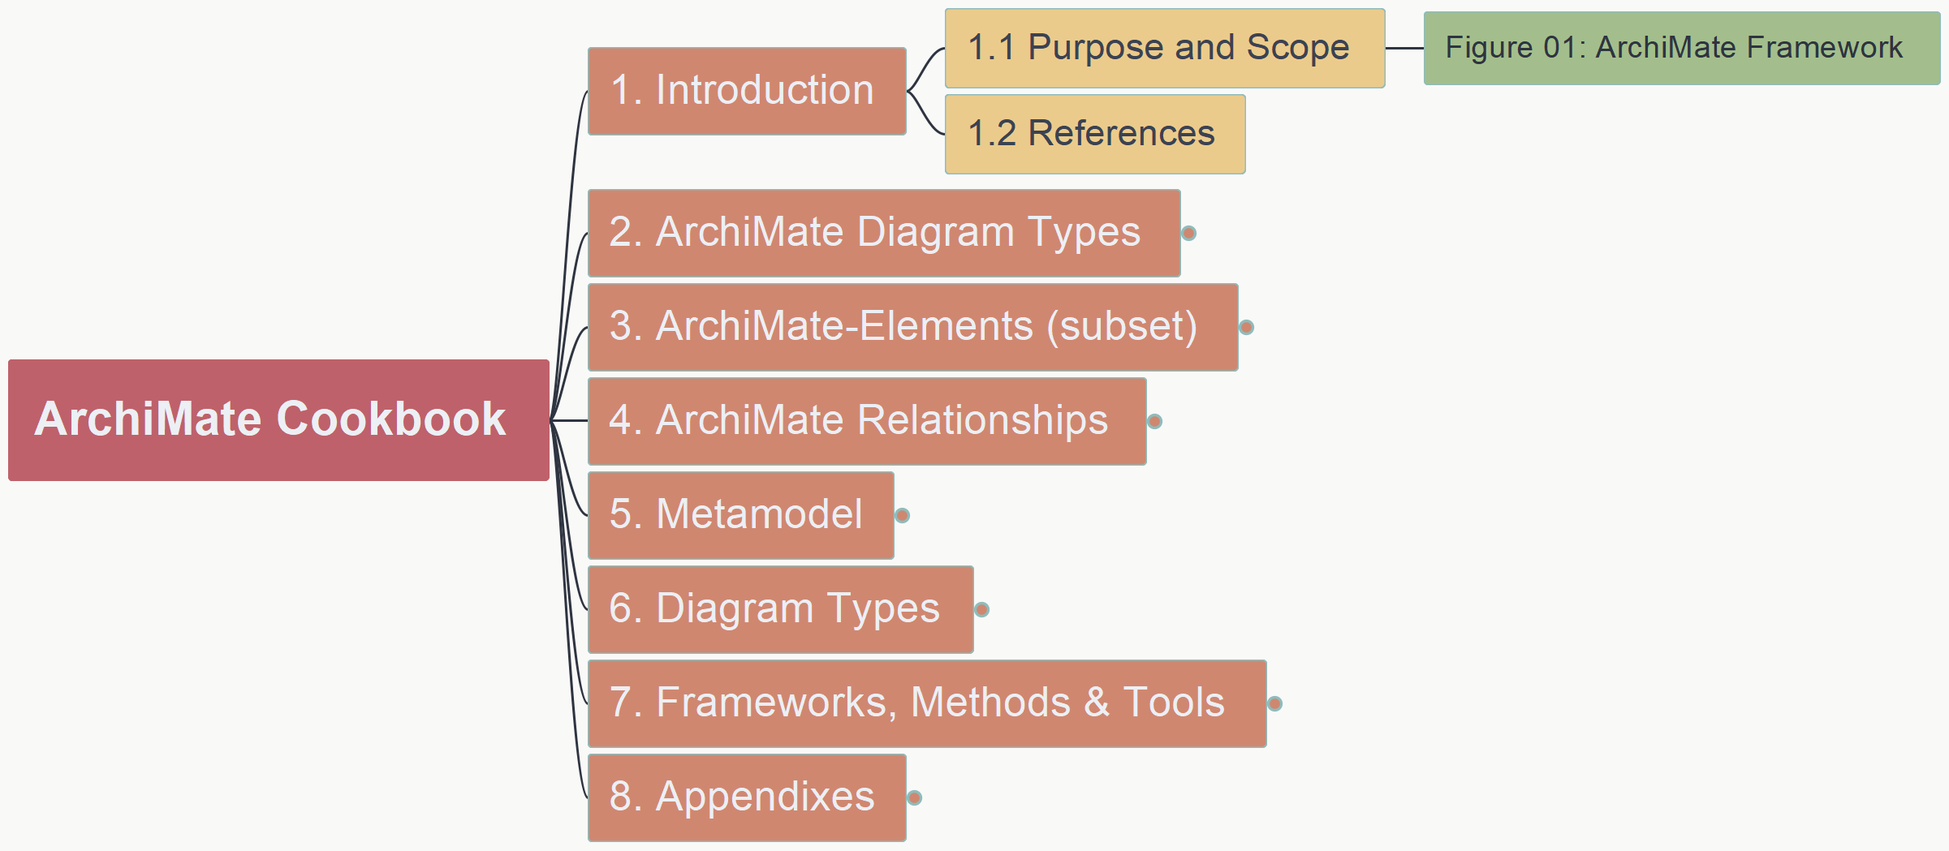
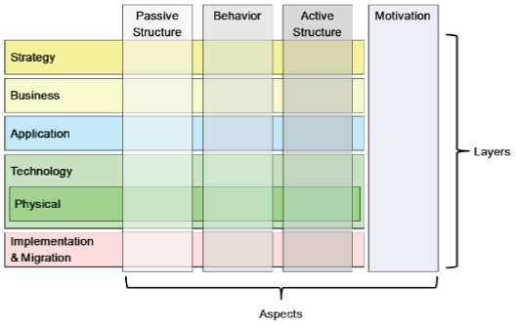
ArchiMate Cookbook
001
1.1 Purpose and Scope

Slide 6
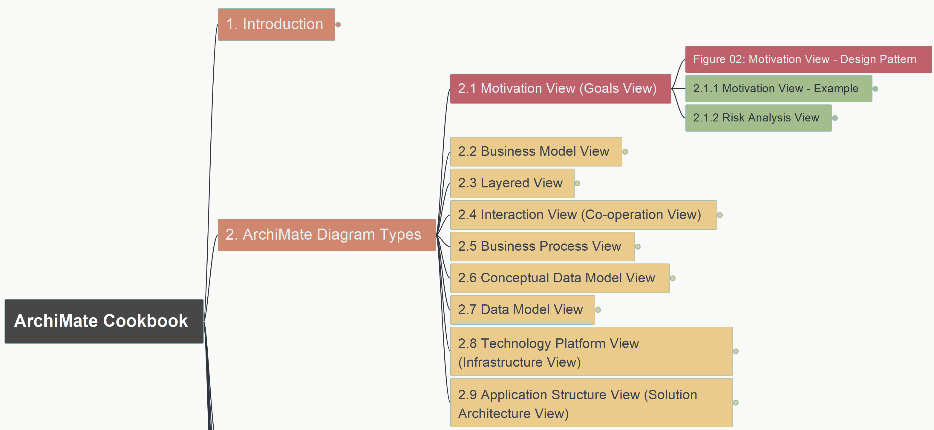
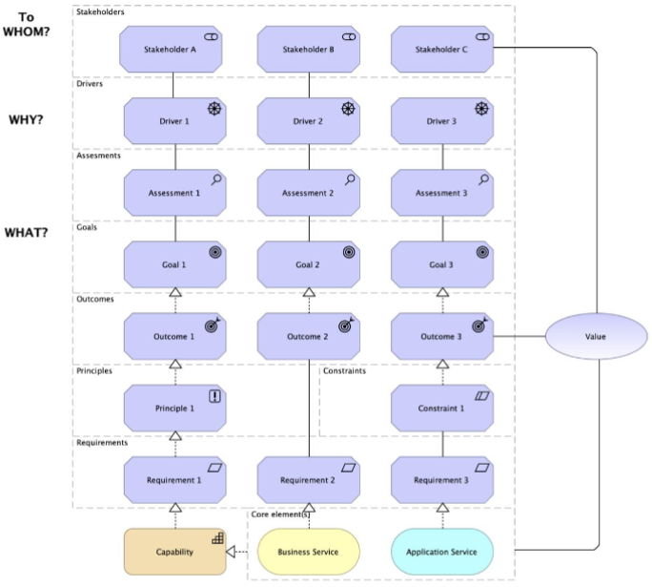
ArchiMate Cookbook
002
2.1 Motivation View (Goals View) – Figure 02

Slide 7
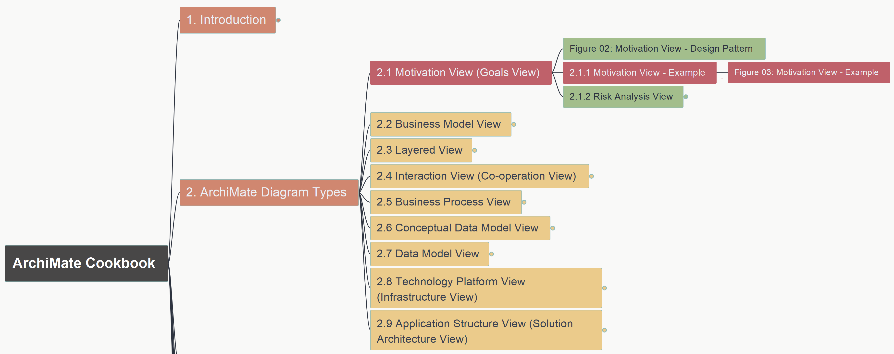
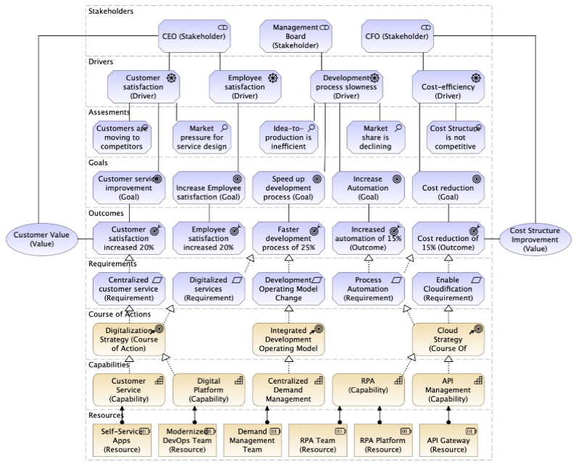
ArchiMate Cookbook
003
2.1 Motivation View (Goals View) – Figure 03

Slide 8
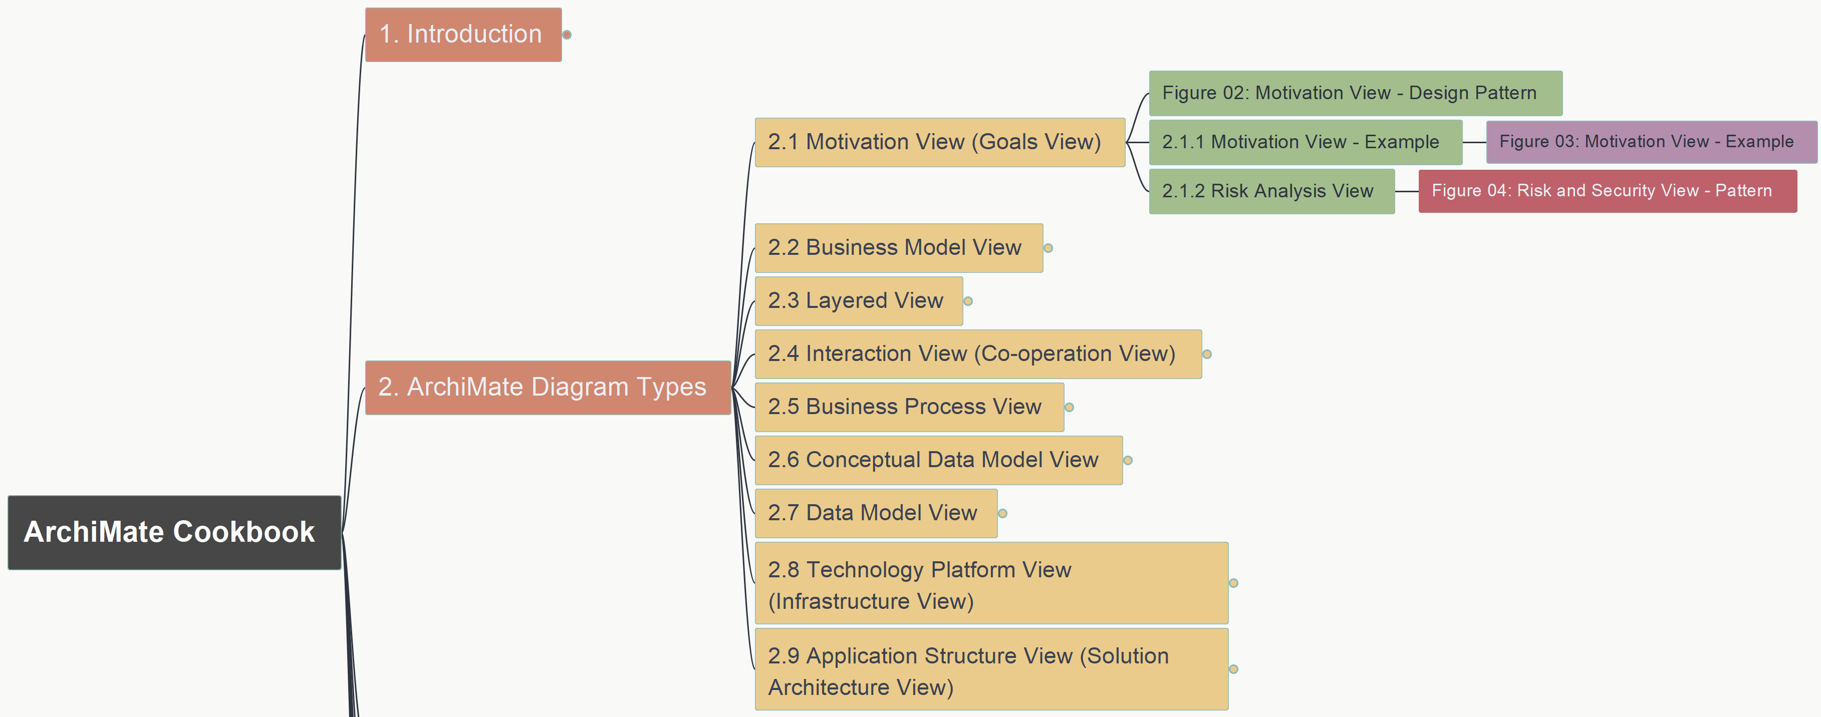
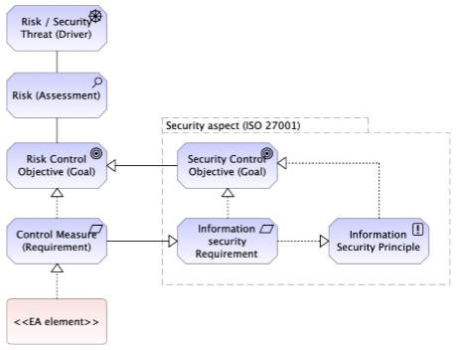
ArchiMate Cookbook
004
2.1 Motivation View (Goals View) – Figure 04

Slide 9
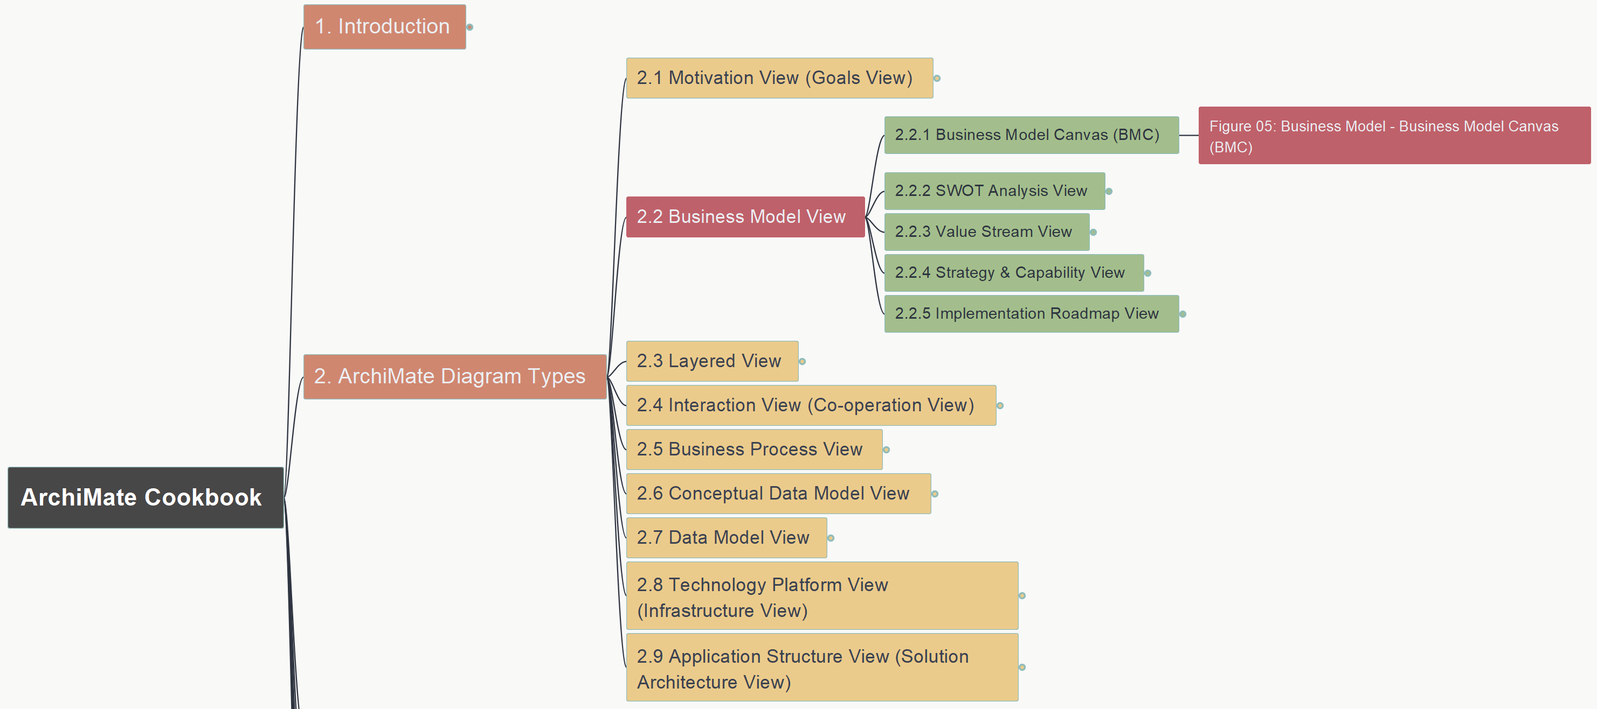
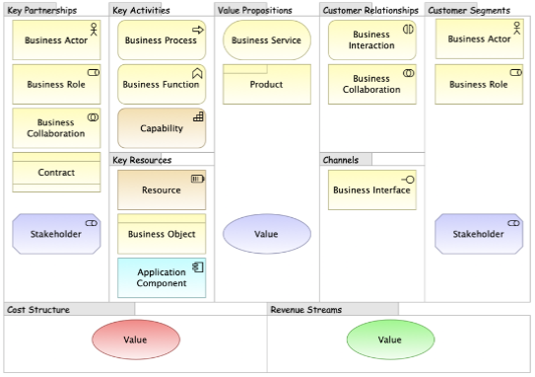
ArchiMate Cookbook
005
2.2 Business Model View – 2.2.1 BMC Figure 05

Slide 10
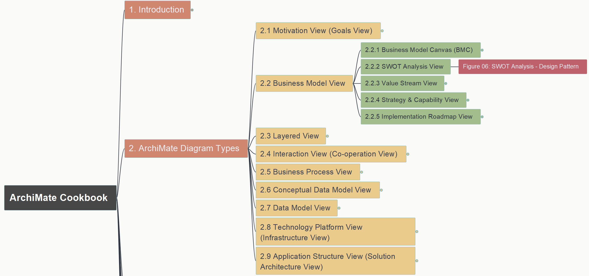
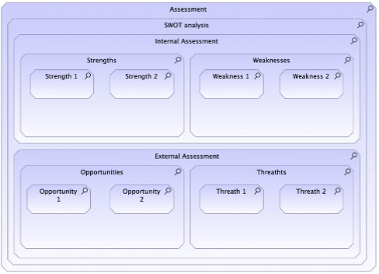
ArchiMate Cookbook
006
2.2 Business Model View – 2.2.2 SWOT Figure 06

Slide 11
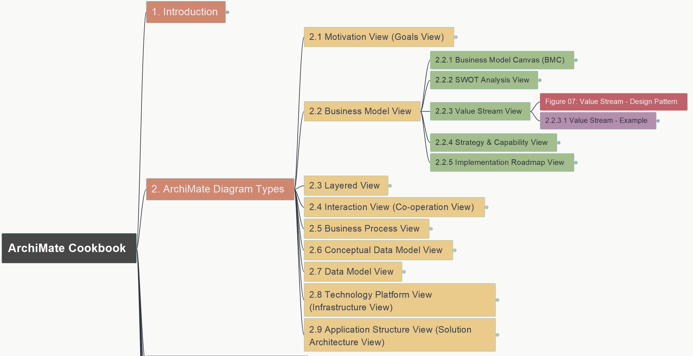
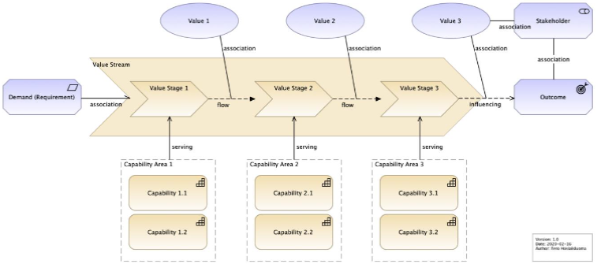
ArchiMate Cookbook
007
2.2 Business Model View – 2.2.3 Value Stream
Figure 07

Slide 12
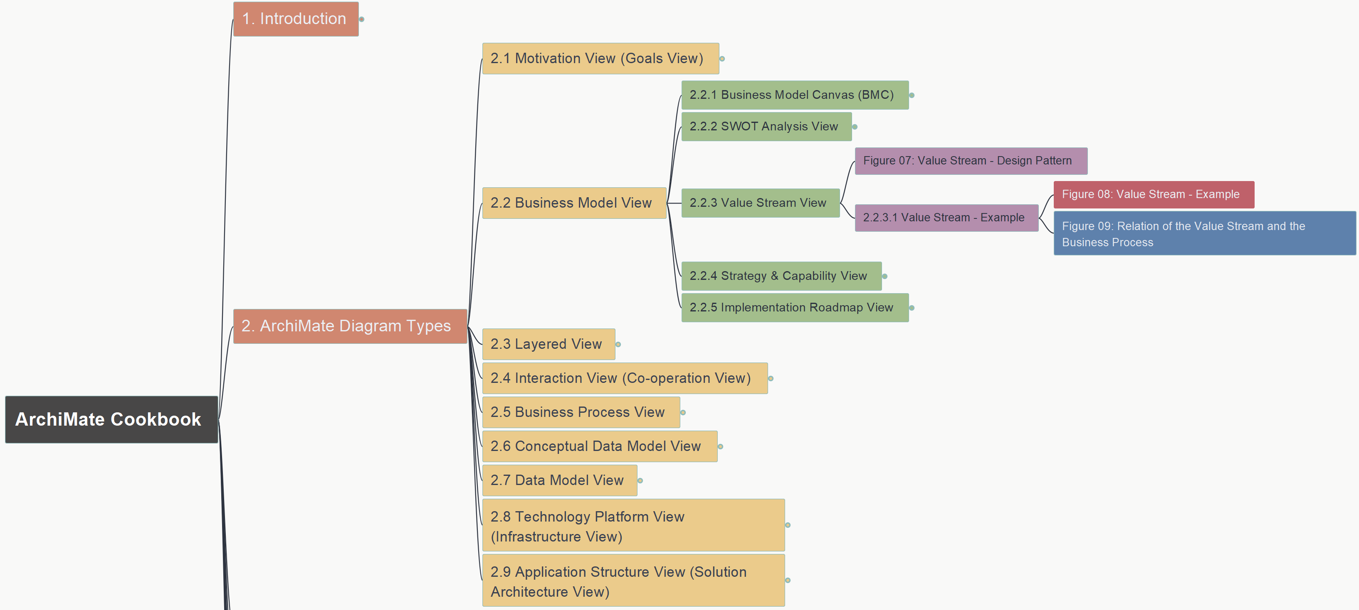
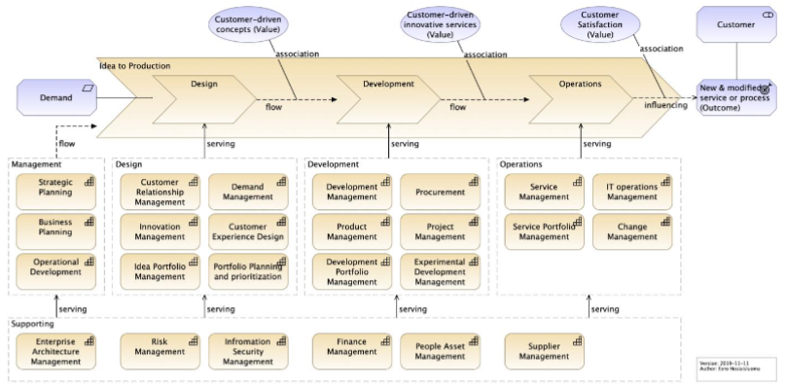
ArchiMate Cookbook
008
2.2 Business Model View – 2.2.3 Value Stream
2-2-3-1 Figure 08

Slide 13
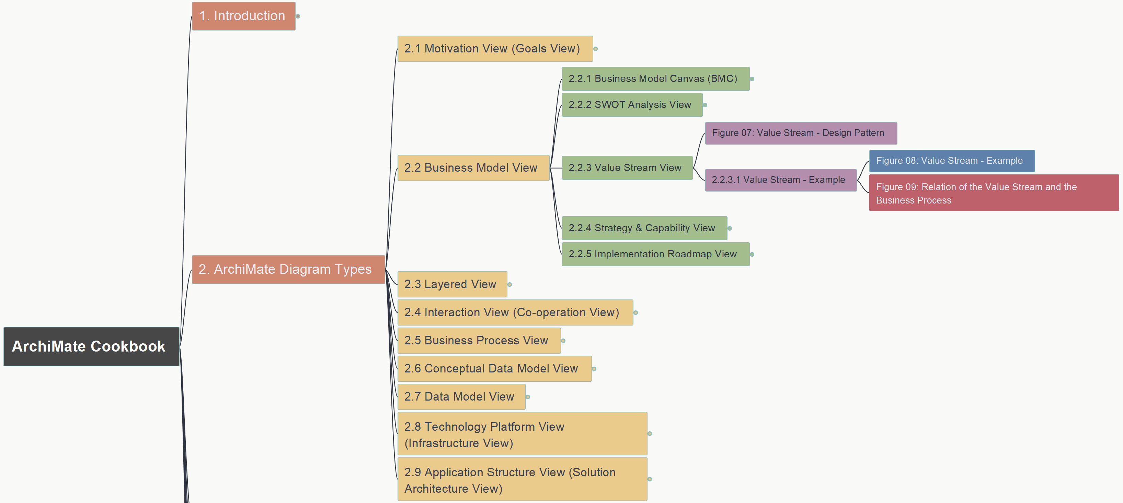
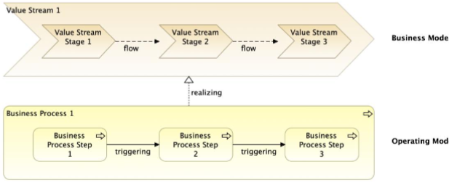
ArchiMate Cookbook
009
2.2 Business Model View – 2.2.3 Value Stream
Figure 09 – Value Stream x Business Process

Slide 14
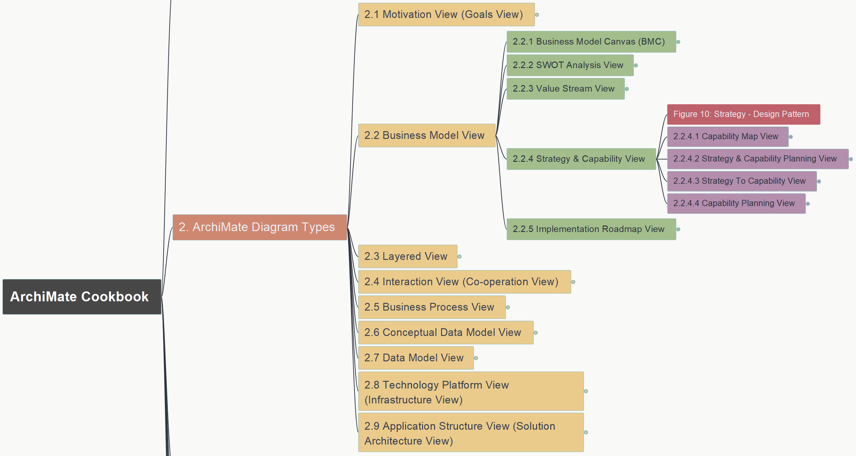
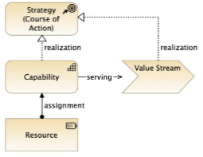
ArchiMate Cookbook
010
2.2 Business Model View – 2.2.4 Strategy & Capability
Figure 10: Strategy – Design Pattern

Slide 15
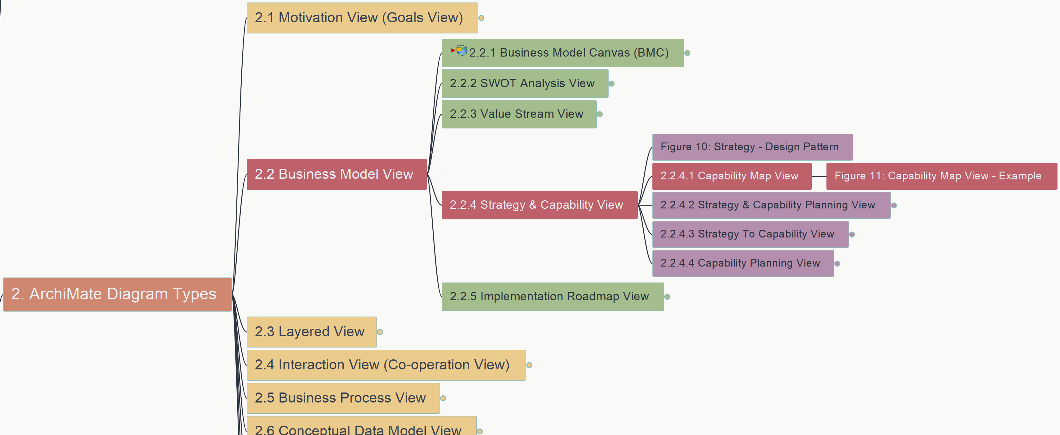
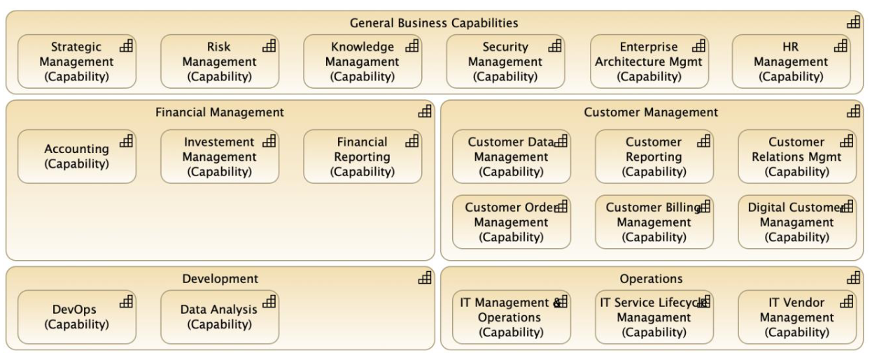
ArchiMate Cookbook
011
2.2 Business Model View – 2.2.4 Strategy & Capability
2.2.4.1 Figure 11: Capability Map View - Example

Slide 16
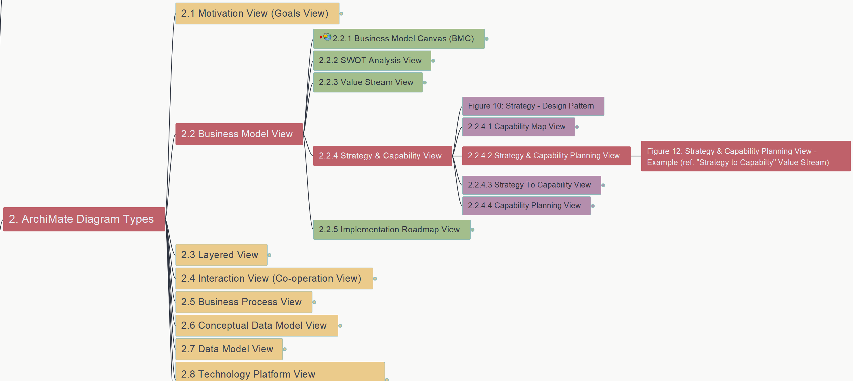
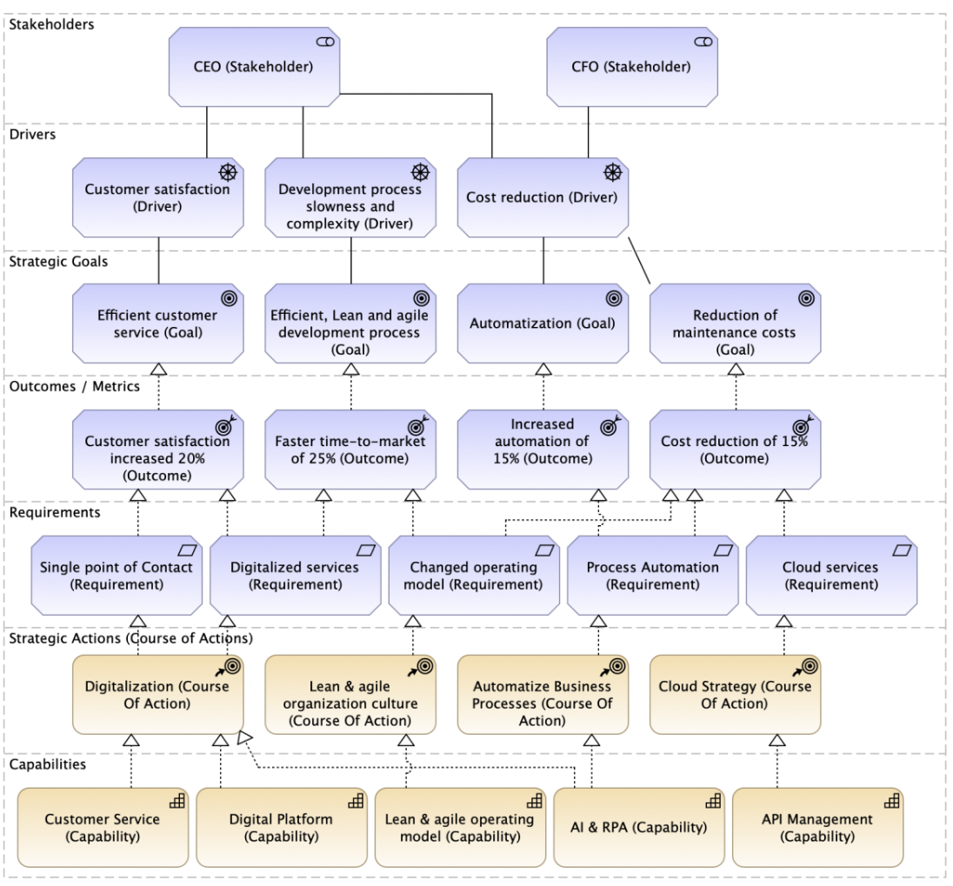
ArchiMate Cookbook
012
2.2 Business Model View – 2.2.4 Strategy & Capability
2.2.4.2 Figure 12: Strategy & Capability Planning View

Slide 17
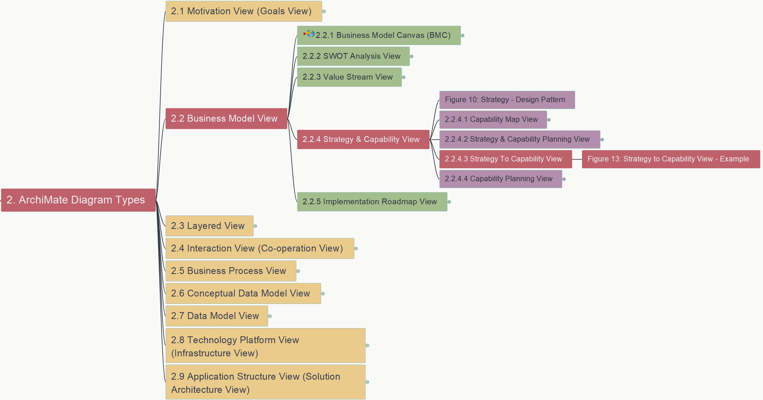
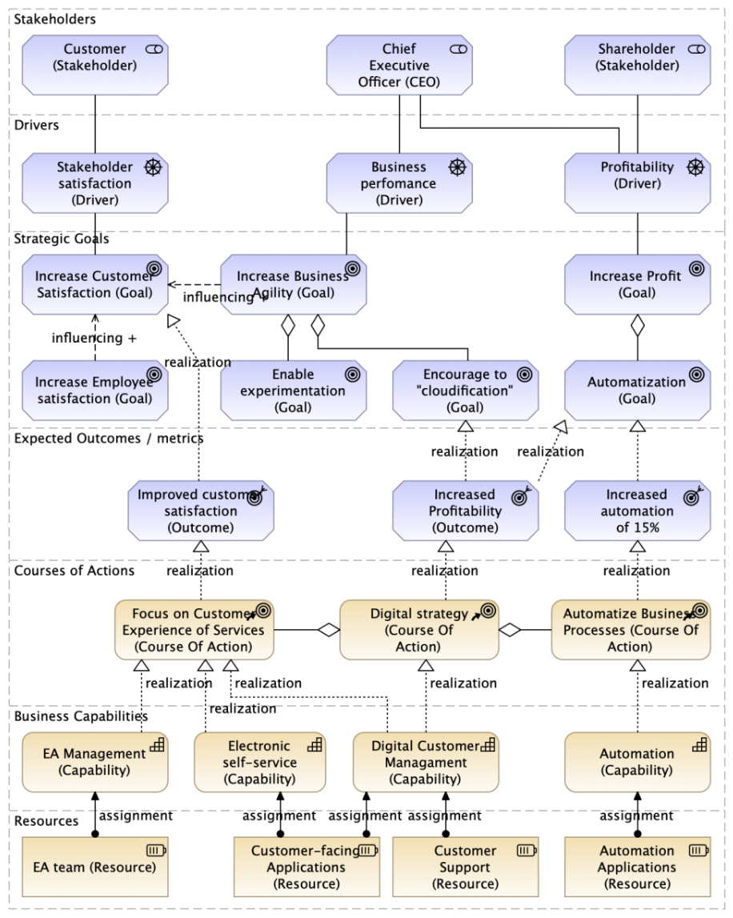
ArchiMate Cookbook
013
2.2 Business Model View – 2.2.4 Strategy & Capability
2.2.4.3 Figure 13: Strategy To Capability View

Slide 18
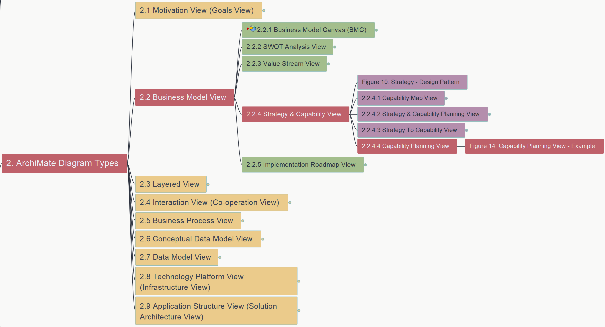
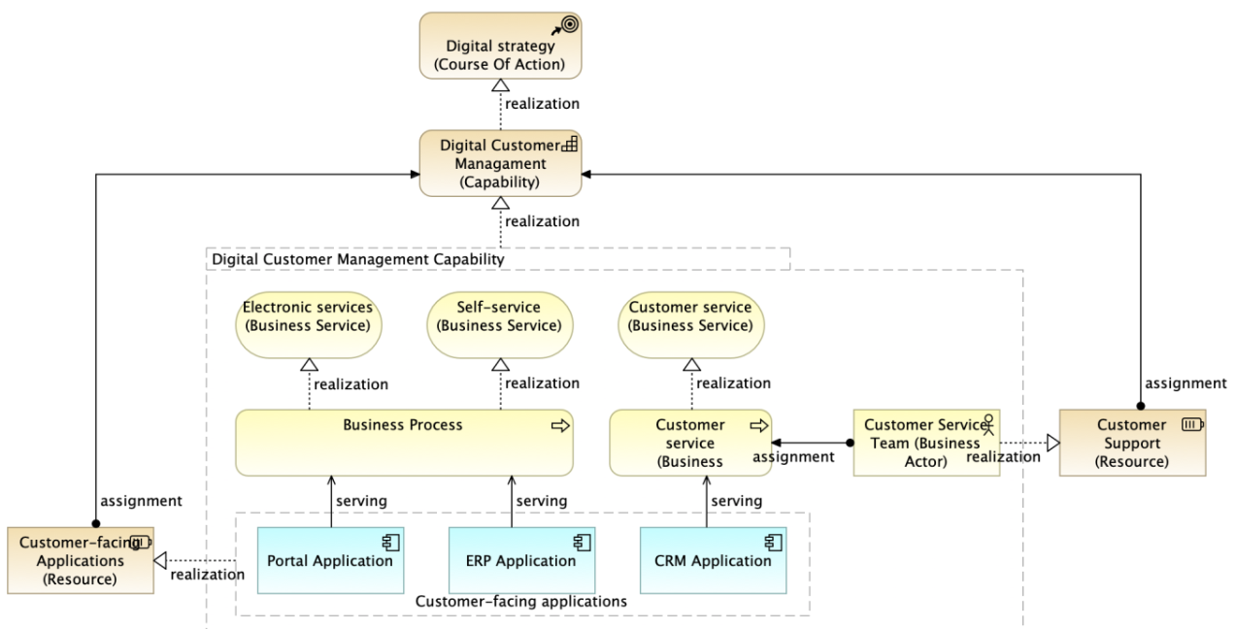
ArchiMate Cookbook
014
2.2 Business Model View – 2.2.4 Strategy & Capability
2.2.4.4 Figure 14: Capability Planning View

Slide 19
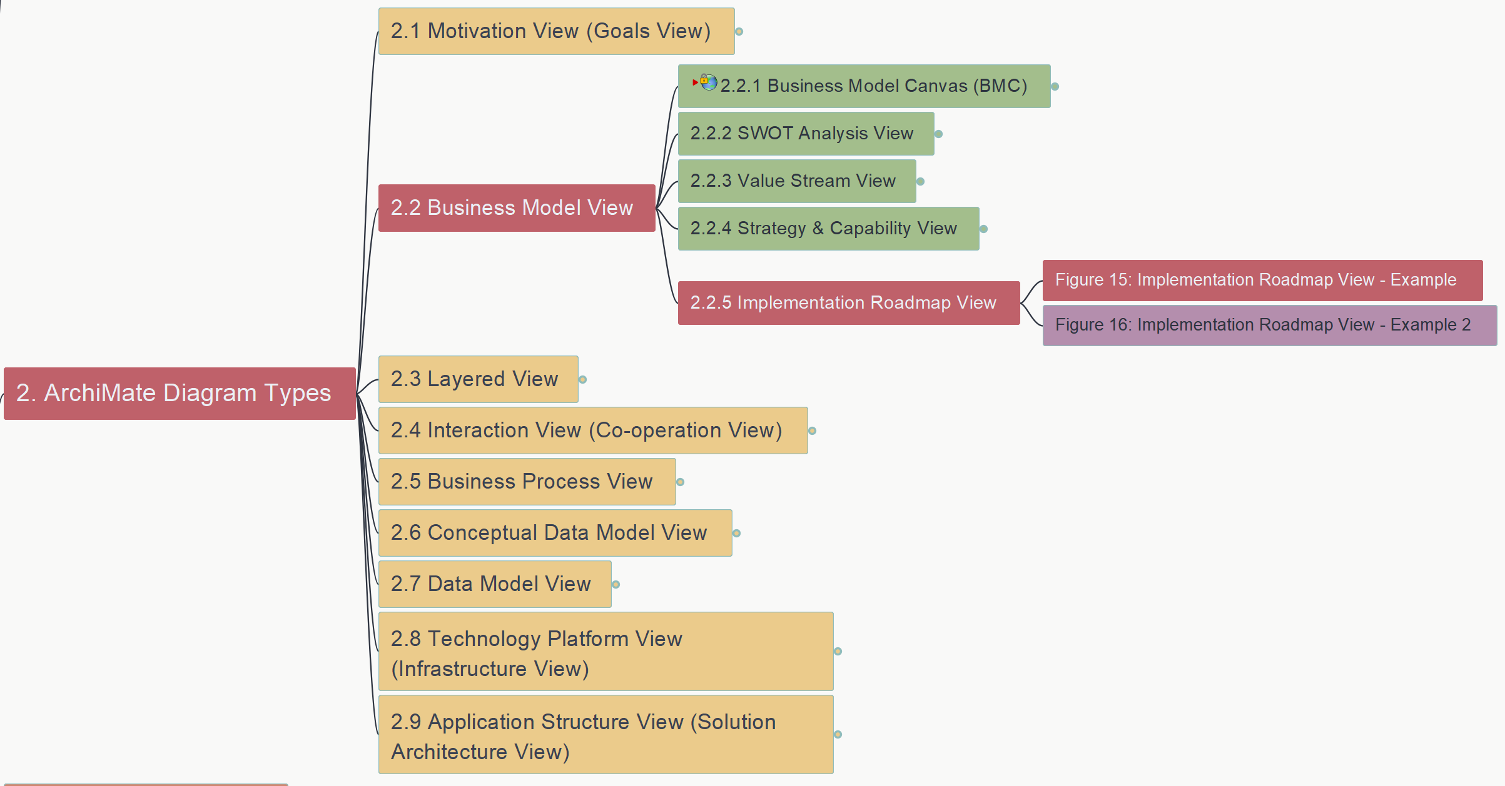
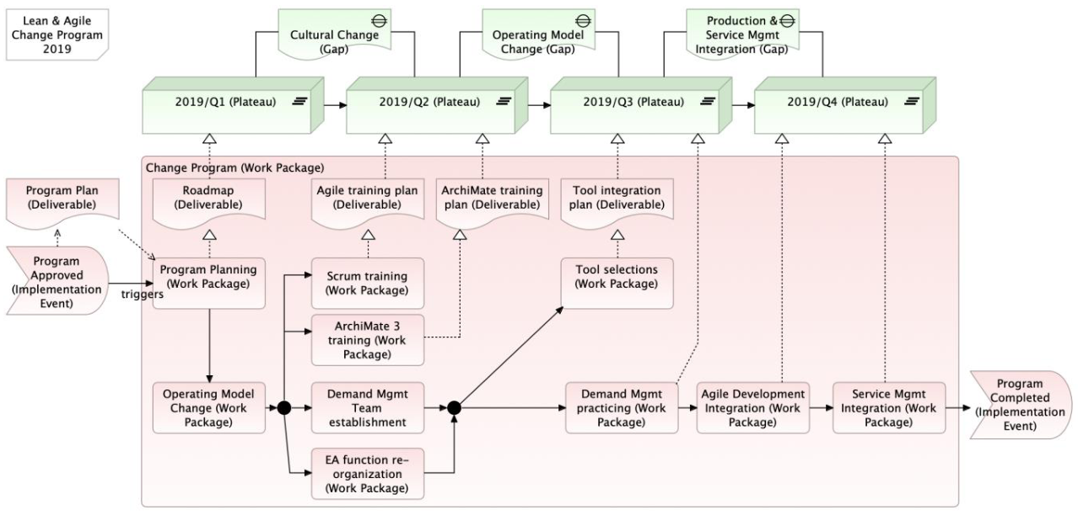
ArchiMate Cookbook
015
2.2 Business Model View – 2.2.5 Implementation Roadmap View
Figure 15: Implementation Roadmap View – Example 1

Slide 20
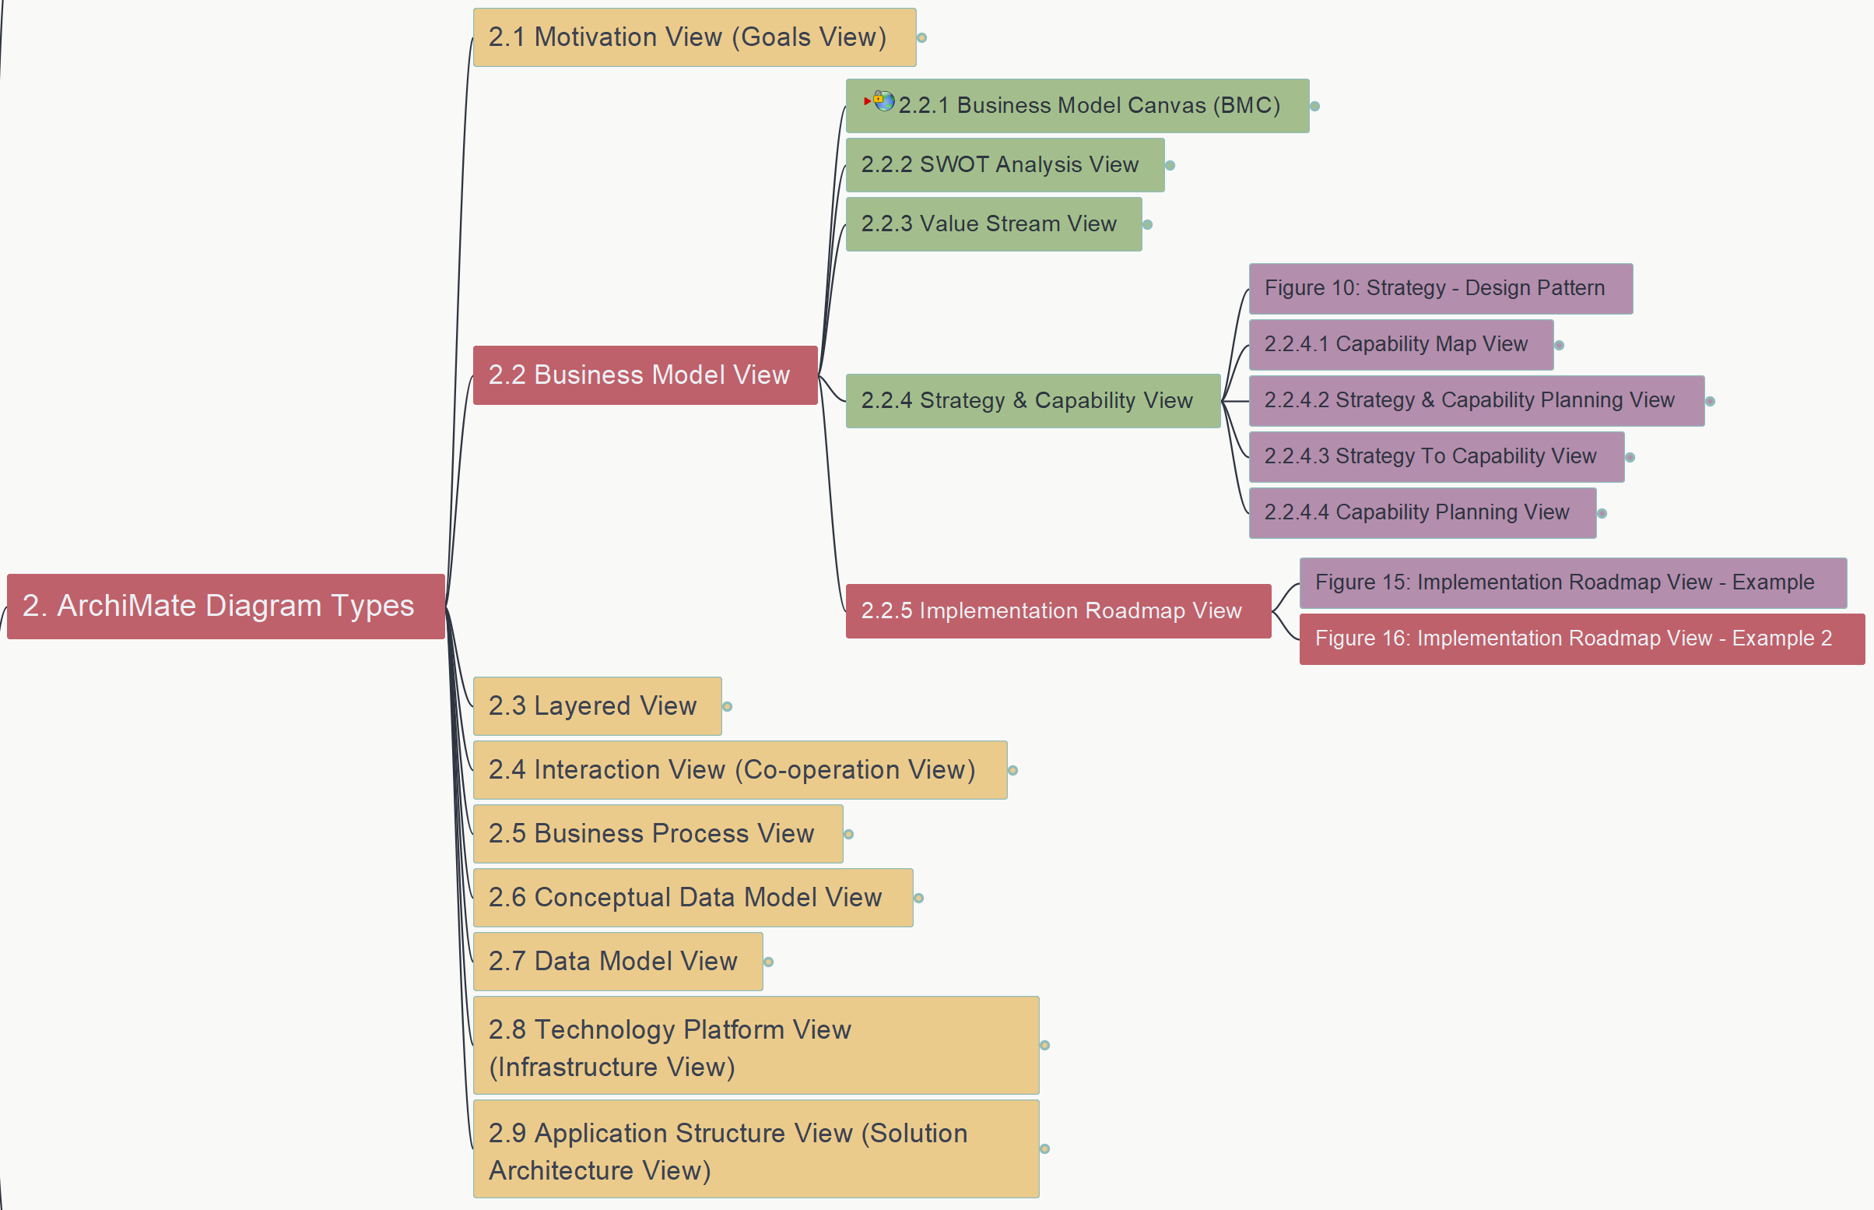
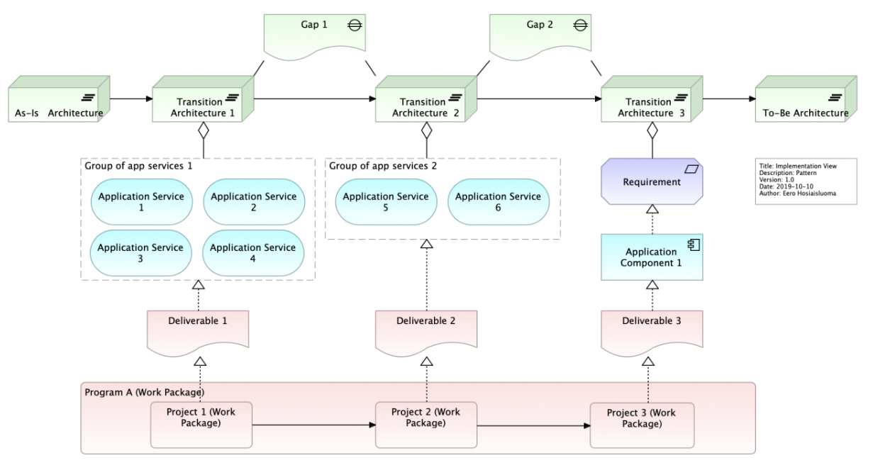
ArchiMate Cookbook
016
2.2 Business Model View – 2.2.5 Implementation Roadmap View
Figure 16: Implementation Roadmap View – Example 2

Slide 21
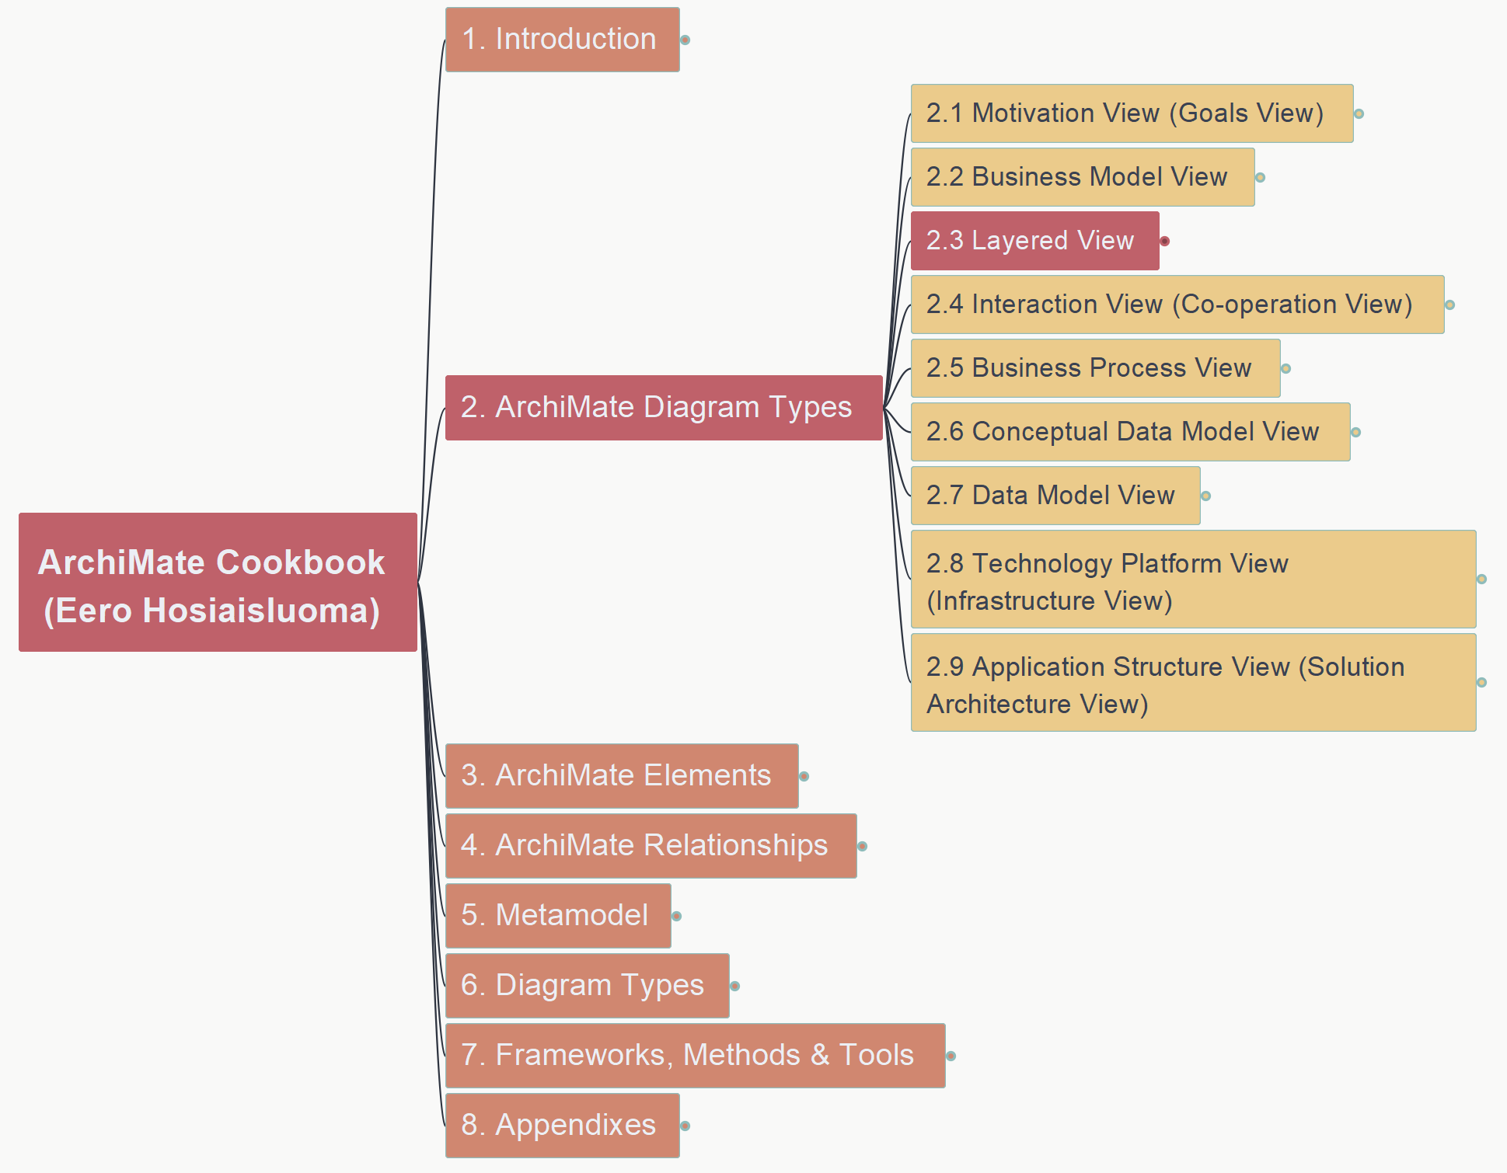
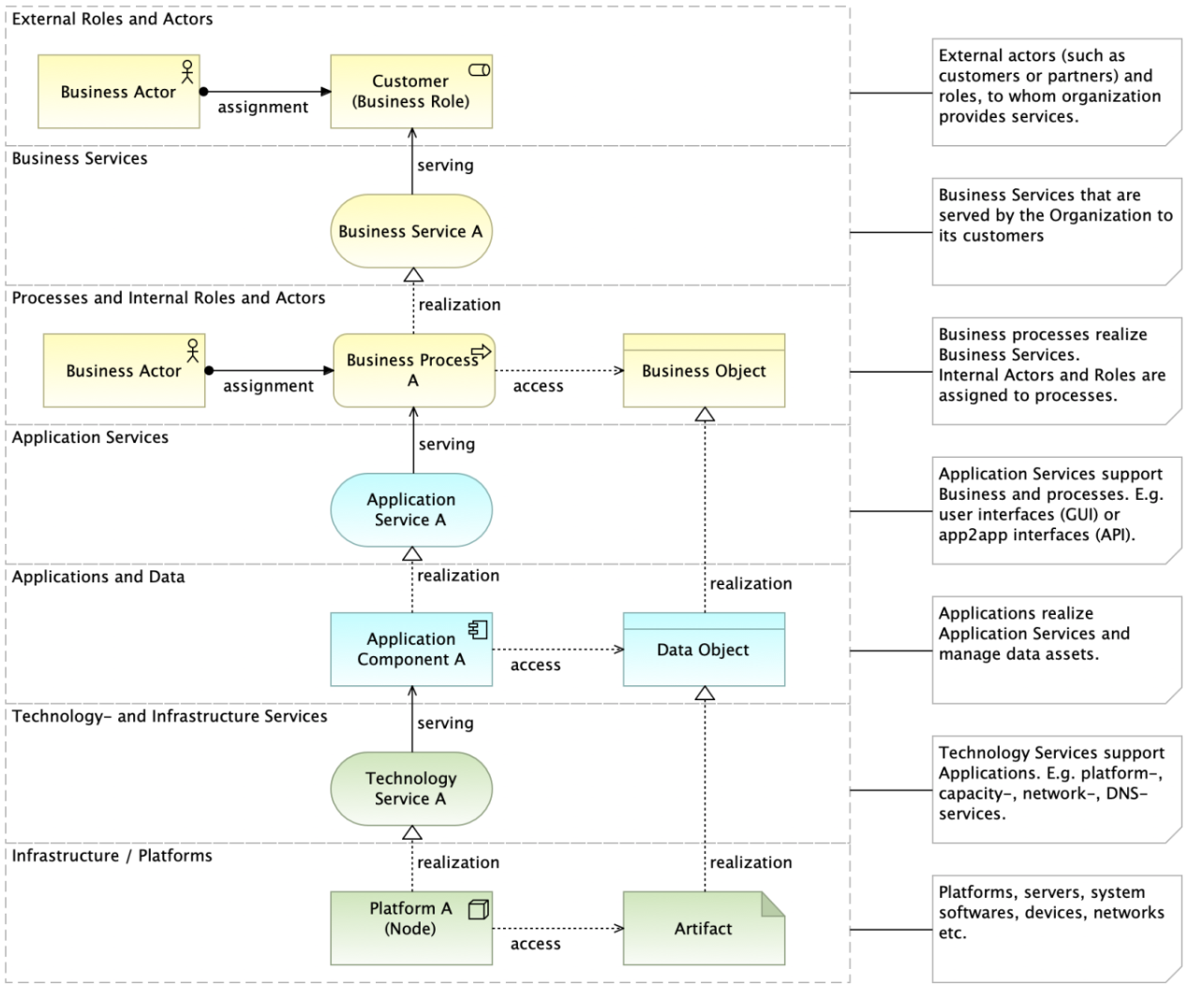
ArchiMate Cookbook
017
2.3 Layered View
Figure 17: Layered View (Overview) – Basic Design Pattern

Slide 22
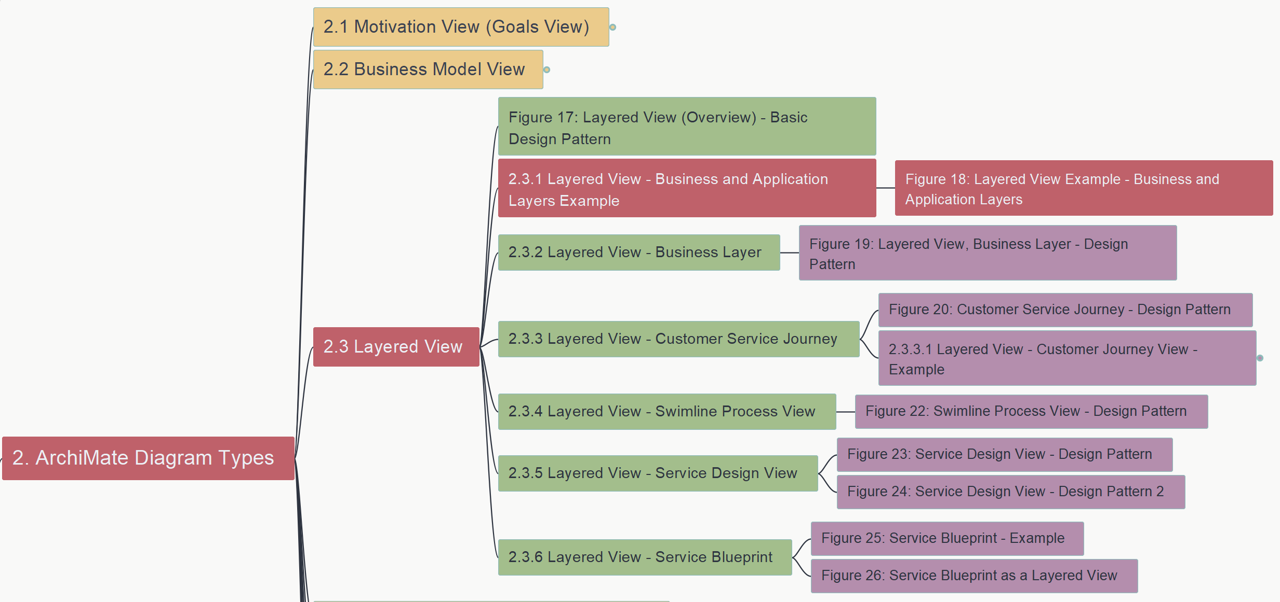
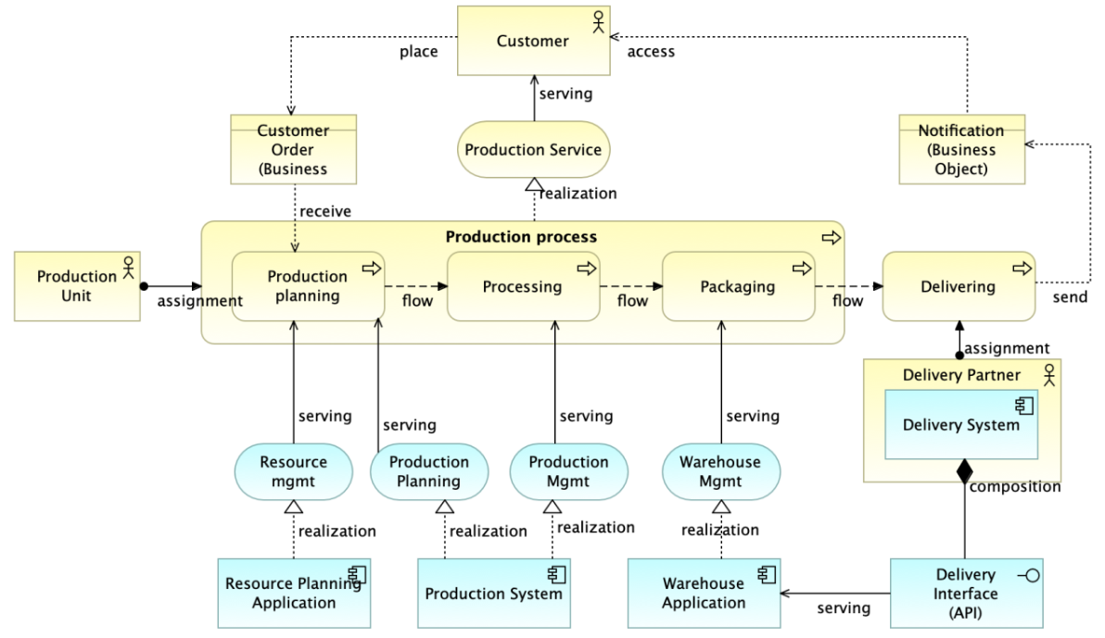
ArchiMate Cookbook
018
2.3 Layered View – 2.3.1 Business- and Application Layers
Figure 18: Layered View Example

Slide 23
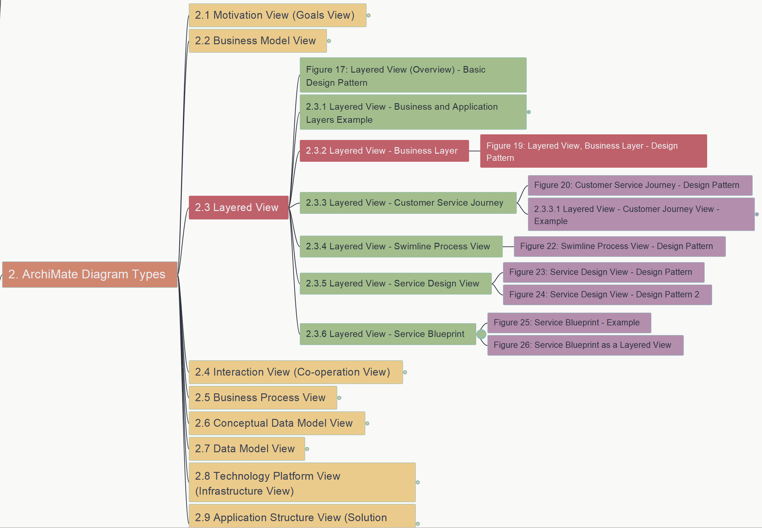
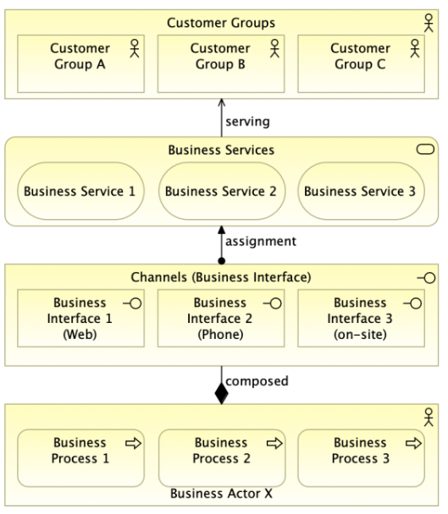
ArchiMate Cookbook
019
2.3 Layered View – 2.3.2 Business Layer
Figure 19: Layered View – Business Layer Design Pattern

Slide 24
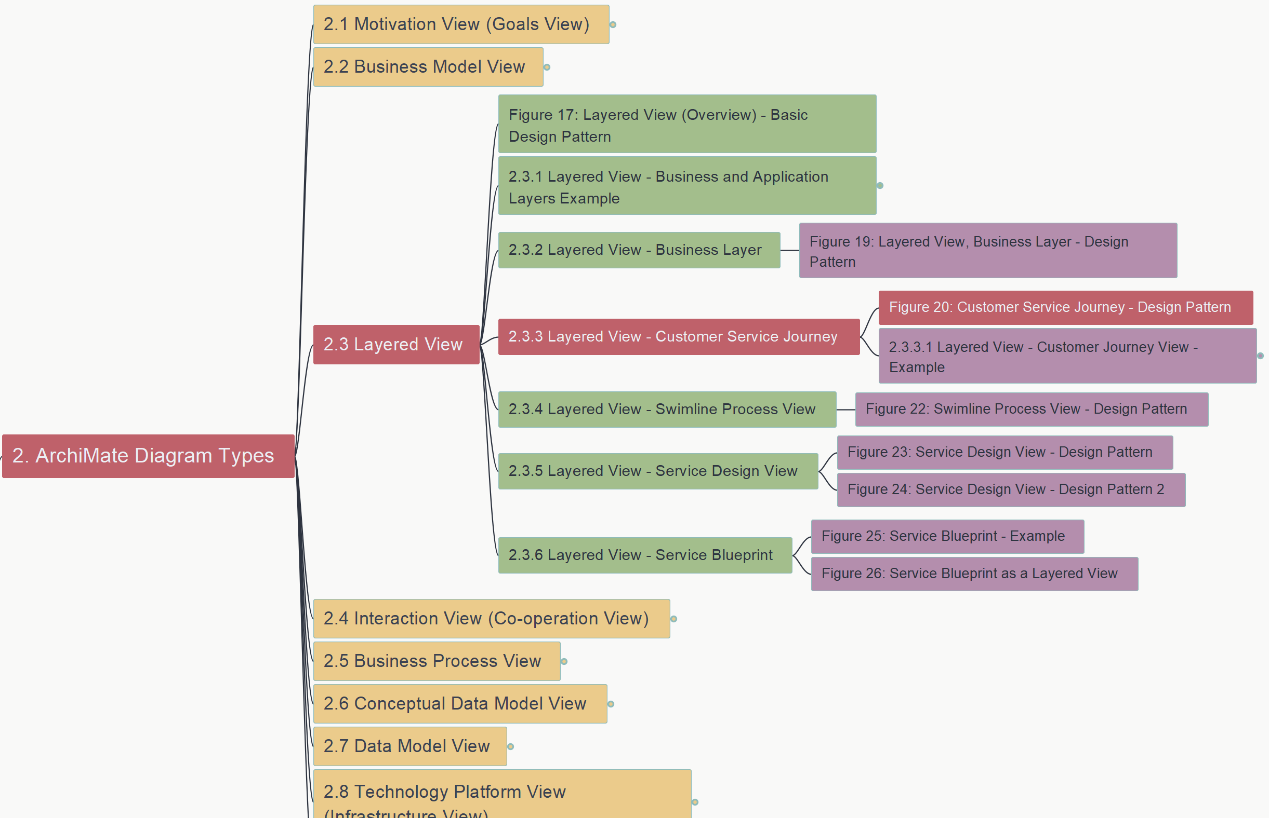
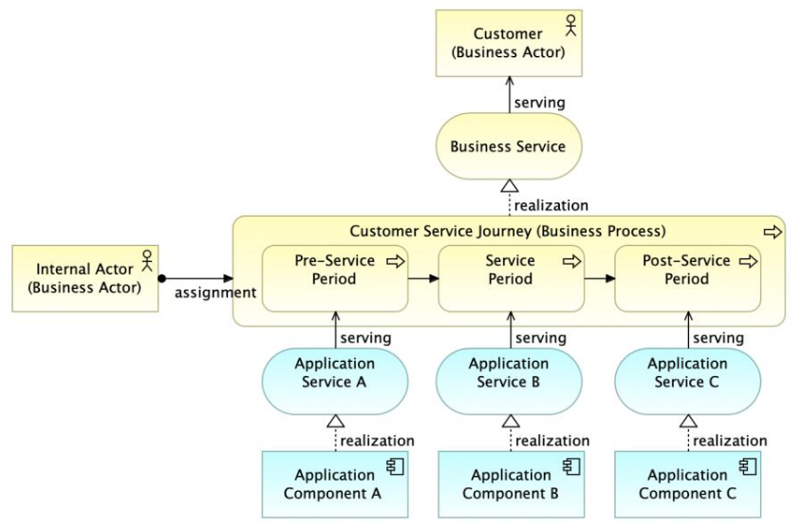
ArchiMate Cookbook
020
2.3 Layered View – 2.3.3 Customer Service Journey
Figure 20: Customer Service Journey - Design Pattern

Slide 25
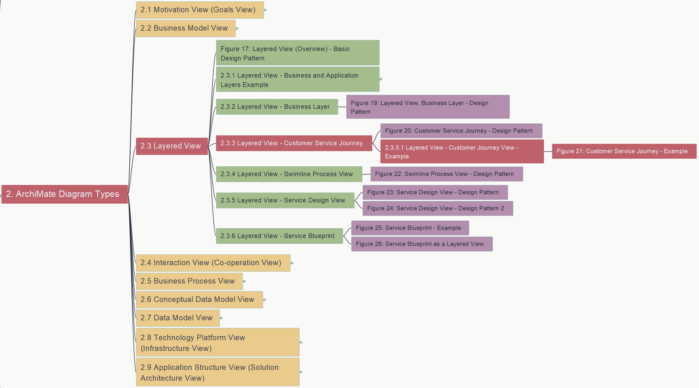
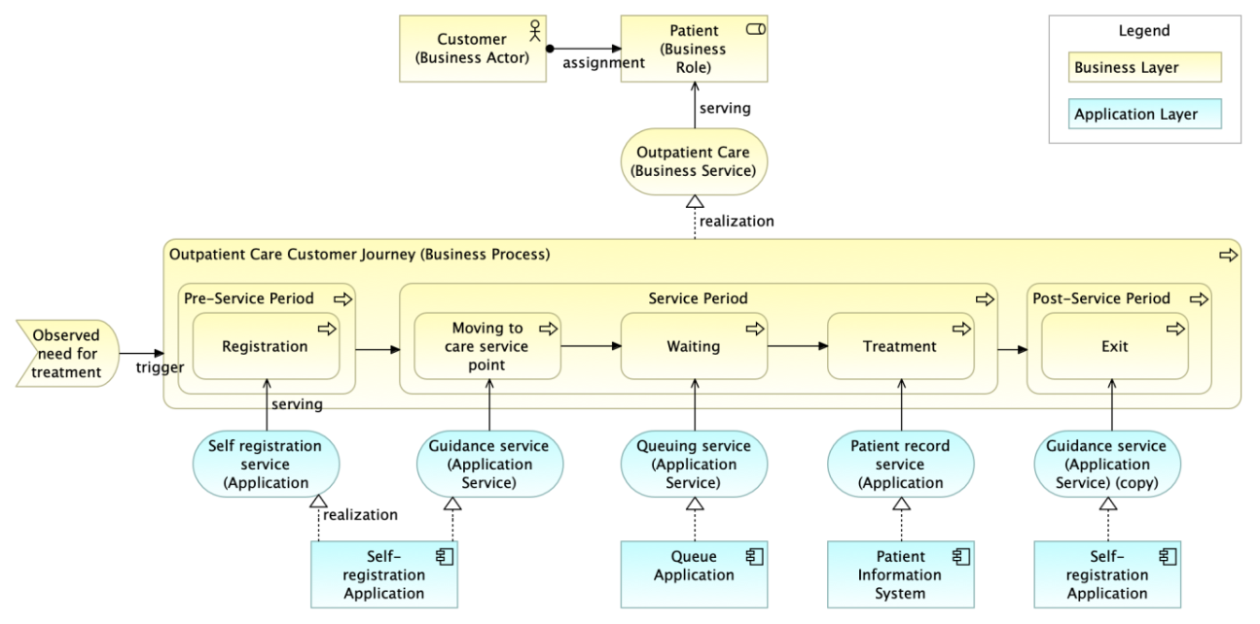
ArchiMate Cookbook
021
2.3 Layered View – 2.3.3 Customer Service Journey
Figure 21: Layered View – Sample for CSJ

Slide 26


ArchiMate Cookbook
022
2.3 Layered View – 2.3.4 Swim-line Process View
Figure 22: Swim-line Process View – Design Pattern

Slide 27


ArchiMate Cookbook
023
2.3 Layered View – 2.3.5 Service Design View
Figure 23: Service Design View – Design Pattern 1

Slide 28


ArchiMate Cookbook
024
2.3 Layered View – 2.3.5 Service Design View
Figure 24: Service Design View – Design Pattern 2

Slide 29


ArchiMate Cookbook
025
2.3 Layered View – 2.3.6 Service Blueprint
Figure 25: Service Blueprint - Example

Slide 30


ArchiMate Cookbook
026
2.3 Layered View – 2.3.6 Service Blueprint
Figure 26: Service Blueprint as a Layered View

Slide 31


ArchiMate Cookbook
027
2.4 Interaction View – 2.4.1 Actor Interaction View
Figure 27: Actor Interaction (Co-operation) View – Design Pattern

Slide 32


ArchiMate Cookbook
028
2.4 Interaction View – 2.4.2 Process Interaction (Co-operation) View
Figure 28: Process Interaction View – Design Pattern

Slide 33


ArchiMate Cookbook
029
2.4 Interaction View – 2.4.3 Application Interaction (Co-operation) View
Figure 29: Application Interaction View – Design Pattern

Slide 34


ArchiMate Cookbook
030
2.5 Business Process View
Figure 30: Process View - Example

Slide 35


ArchiMate Cookbook
031
2.5 Business Process View – 2.5.1 Business Process Functional Decomposition
Figure 31: Business Function View

Slide 36


ArchiMate Cookbook
032
2.5 Business Process View – 2.5.1 Business Process Functional Decomposition
Figure 32: Business Process Map

Slide 37


ArchiMate Cookbook
033
2.6 Conceptual Data Model View
Figure 33: Conceptual Data Model View - Example

Slide 38


ArchiMate Cookbook
034
2.7 Data Model View
Figure 34: Data Model View - Example

Slide 39


ArchiMate Cookbook
035
2.8 Technology Platform View (Infrastructure View)
Figure 35: Technology Platform View – Design Pattern

Slide 40


ArchiMate Cookbook
036
2.8 Technology Platform View (Infrastructure View)
Figure 36: Technology Platform – Example

Slide 41


ArchiMate Cookbook
037
2.9 Application Structure View (Solution Architecture View)
2.9.1 Application Design Pattern – Figure 37

Slide 42


ArchiMate Cookbook
038
2.9 Application Structure View (Solution Architecture View)
2.9.1 Application Design Pattern – Figure 38

Slide 43


ArchiMate Cookbook
039
2.9 Application Structure View (Solution Architecture View)
2.9.1 Application View – Design Pattern – Figure 39

Slide 44


ArchiMate Cookbook
040
2.9 Application Structure View (Solution Architecture View)
2.9.2 Application Logical Structure View – Figure 40

Slide 45


ArchiMate Cookbook
041
2.9 Application Structure View (Solution Architecture View)
2.9.2 Application Logical Structure View – Figure 41

Slide 46


ArchiMate Cookbook
042
2.9 Application Structure View (Solution Architecture View)
2.9.2 Application Logical Structure View – Figure 42

Slide 47


ArchiMate Cookbook
043
2.9 Application Structure View (Solution Architecture View)
2.9.3 Component Model (CM) – 2.9.3.1 Figure 43: CM-0

Slide 48


ArchiMate Cookbook
044
2.9 Application Structure View (Solution Architecture View)
2.9.3 Component Model (CM) – 2.9.3.2 Figure 44: CM-1

Slide 49


ArchiMate Cookbook
045
2.9 Application Structure View (Solution Architecture View)
2.9.3 Component Model (CM) – 2.9.3.3 Figure 45: CM-2

Slide 50


ArchiMate Cookbook
046
2.9 Application Structure View (Solution Architecture View)
2.9.4 Database – Figure 46: Logical Database View

Slide 51


ArchiMate Cookbook
047
2.9 Application Structure View (Solution Architecture View)
2.9.4 Database – Figure 47: Data Model View

Slide 52


ArchiMate Cookbook
048
2.9 Application Structure View (Solution Architecture View)
2.9.4 Database – Figure 48: DB as Component of App

Slide 53


ArchiMate Cookbook
049
2.9 Application Structure View (Solution Architecture View)
2.9.4 Database – Figure 49: DB Modeling

Slide 54


ArchiMate Cookbook
050
2.9 Application Structure View (Solution Architecture View)
2.9.5 Application Integration – 2.9.5.1 Figure 50

Slide 55


ArchiMate Cookbook
051
2.9 Application Structure View (Solution Architecture View)
2.9.5 Application Integration – 2.9.5.2 Figure 51: Design Pattern

Slide 56


ArchiMate Cookbook
052
2.9 Application Structure View (Solution Architecture View)
2.9.5 Application Integration – 2.9.5.2 Figure 52: ETL

Slide 57


ArchiMate Cookbook
053
2.9 Application Structure View (Solution Architecture View)
2.9.6 Sequence Diagrams – 2.9.6.1 Figure 53

Slide 58


ArchiMate Cookbook
054
2.9 Application Structure View (Solution Architecture View)
2.9.6 Sequence Diagrams – 2.9.6.2 Figure 54

Slide 59


ArchiMate Cookbook
055
2.9 Application Structure View (Solution Architecture View)
2.9.7 Application Integration Patterns – Figure 55

Slide 60


ArchiMate Cookbook
056
2.9 Application Structure View (Solution Architecture View)
2.9.8 Use Case View – Figure 56: Design Pattern

Slide 61


ArchiMate Cookbook
057
2.9 Application Structure View (Solution Architecture View)
2.9.8 Use Case View – Figure 57: Analysis

Slide 62


ArchiMate Cookbook
058
2.9 Application Structure View (Solution Architecture View)
2.9.8 Use Case View – 2.9.8.1 Figure 58: Example1

Slide 63


ArchiMate Cookbook
059
2.9 Application Structure View (Solution Architecture View)
2.9.8 Use Case View – 2.9.8.1 Figure 59: Example2

Slide 64



How to Load Large Volume of Elements with Relationships through CSV Export/Import?
Q&A
1000 Elements
+ Relationships

Slide 65
Steps of CSV Export/Import
Create one new Archi model
Add one parent and one child element, add relationship (and clear view)
Export to CSV
Change the default random ID to your ID Naming Standard, in both element and relation file
Add elements and relationships, matching with the data model
Create one another new Archi model for Import testing
If the result is as expected, export working model file
Paste elements and relationship from testing CSV to the end of the working model CSV file
Import working model CSV

Slide 66
Understand Archi CSV Export
1 of 3
CSV Export file structure
How to create the load elements.csv and relations.csv files?
How to load base one diagram?
# of Elements
+ Relationships

Slide 67
Understand Archi CSV Export
2 of 3
CSV Export file structure
How to create the load elements.csv and relations.csv files?
How to load base one diagram?
# of Elements
+ Relationships
Notes:
Another question: Towards the end of the course, you have the Working models with Application Component, Actor, Business Processes, Application Service and Location. Can you show how we can load data from .csv if there are say, 20 objects of each of the different elements, except Actor that'd have say 5. I'd like to understand how to create the load elements.csv and relations.csv files.

Slide 68
Understand Archi CSV Export
3 of 3
CSV Export file structure
How to create the load elements.csv and relations.csv files?
How to load base one diagram?
# of Elements
+ Relationships

